Slide 1
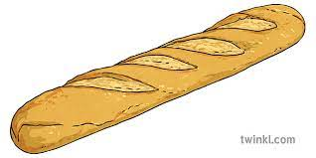
The Baguette : The famous « French Stick »

Slide 2
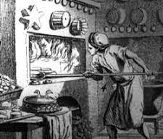
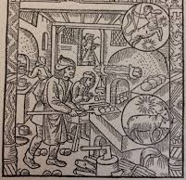
The French Baguette History : Myth or true story
The idea of long bread imported from Vienna in the 19th century
The baguette is « a product » of the French Revolution : Le pain Egalité
Its elongated shape would be chosen by Napoleon for its soldiers
The world « Baguette » appears in october 1920

Slide 3
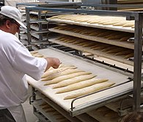
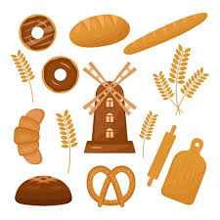
How do we make the famous baguette ?
Wheat flour, water, yeast, and common salt
Typically weighs around 250 g and 55 and 65 cm long
Le Décret Pain (1993), the French Bread Law protects the traditional baguette from other industrial breads

Slide 4
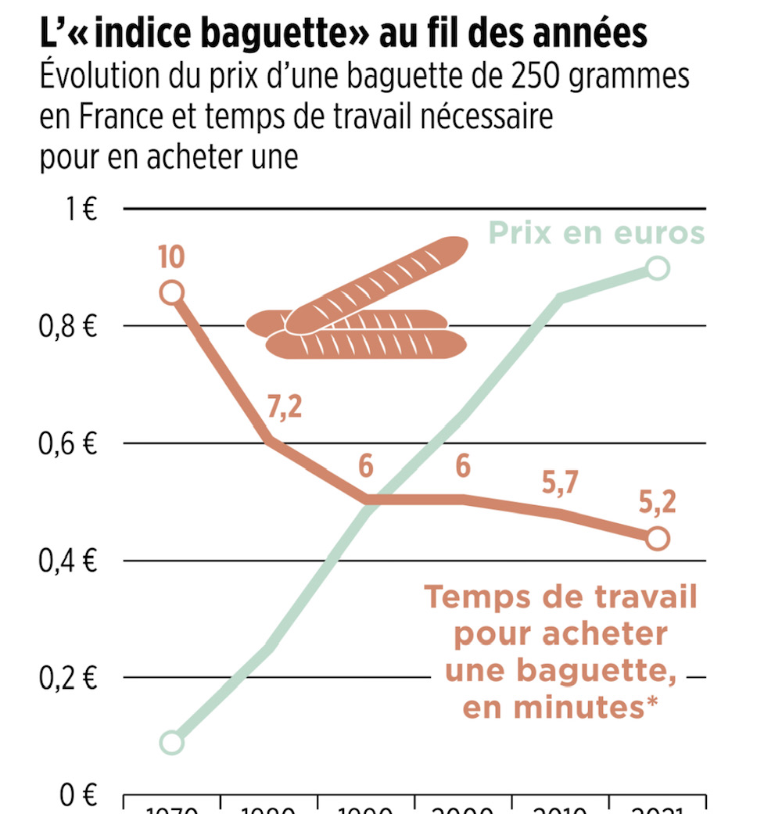
The baguette : Nowadays : some data
Every second : 320 baguettes sold in the world; 10 billions per year
32,000 bakeries in France
2018 : France has chosen the baguette as its candidate
for UNESCO intangible cultural heritage status
95% of french people eat bread for lunch or diner
The price increased more the 24% during the ten last years

Slide 5
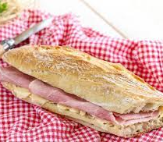
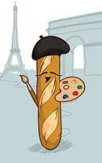
One of the most Iconic Food in Paris
The of unofficial symbol of Paris and moreover of France
Baguette is included in the famous « French Breakfast ». It is used to prepare the famous French sandwich
One of the most famous product of the French gastronomy as cheese and wine

