Slide 1
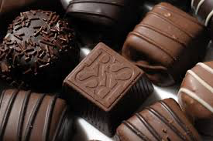
Made in France
Lindt & Sprüngli chocolate

Slide 2
The “Made in France” label
- The product must have been put together in France
The production process must deliver on a certain standard of quality, and respect human rights
All of the codes related to the consummation and release of the product that are applicable in the country in which the product will go on sale must be respected

Slide 3
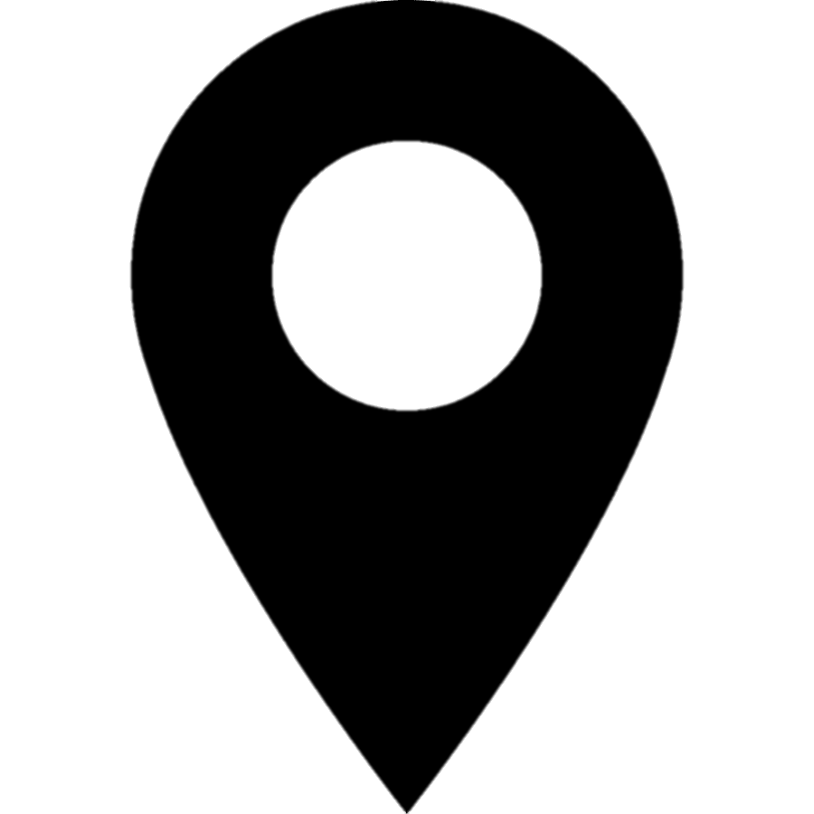
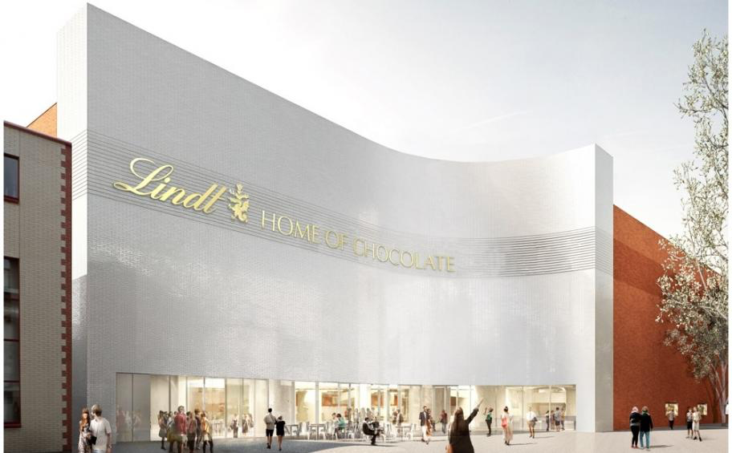
Headquarters
Kilchberg, Zürich (Switzerland)

Slide 4
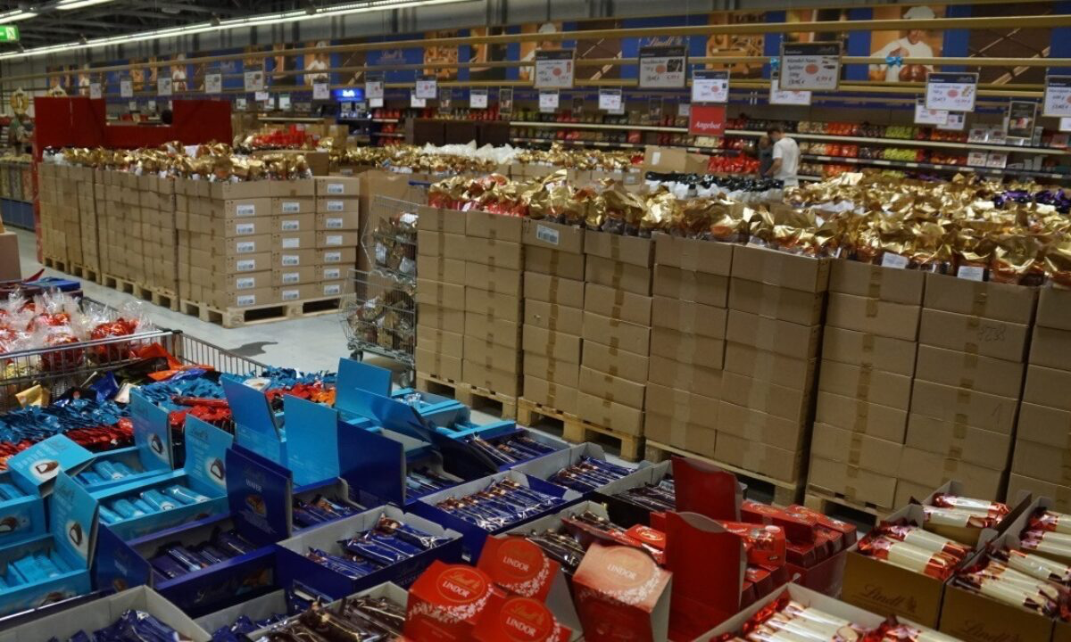
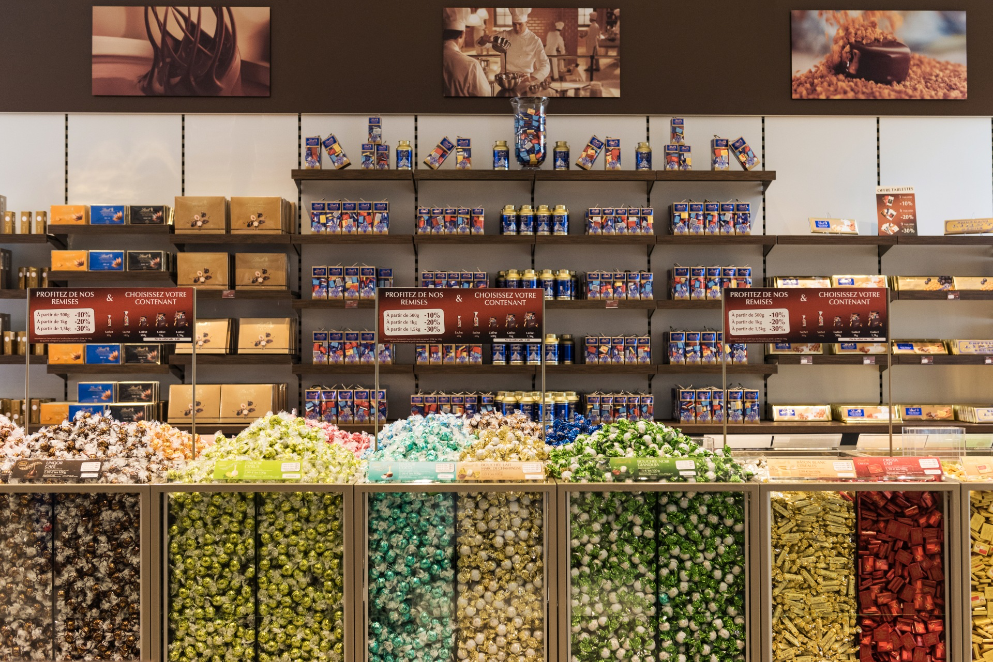
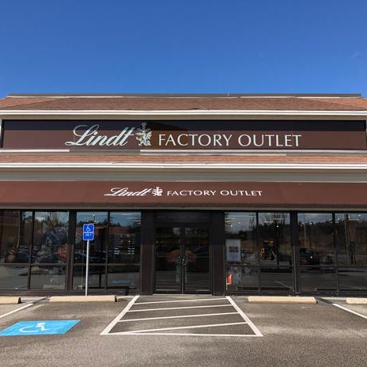
Other important production sites
Aachen (Germany)
12 factories
Oloron-Sainte-Marie (France)
Stratham, New-Hampshire (United-States)

Slide 5
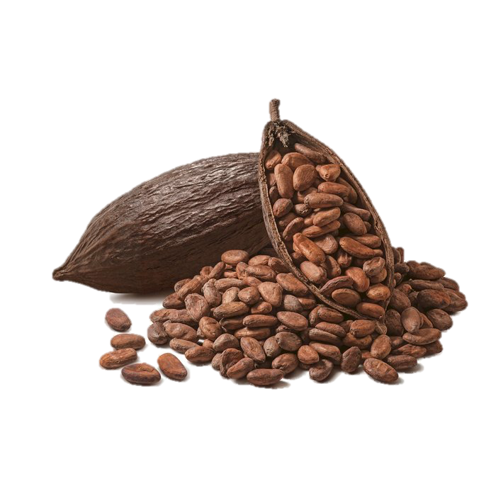
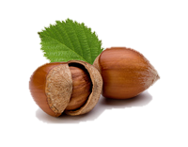
Supply chain
High quality raw materials (cocoa beans, dried fruits, other fruits, spices, packaging necessities)
The Lindt & Sprüngli Farming Programm
The Lindt & Sprüngli Supplier Code of Conduct

Slide 6
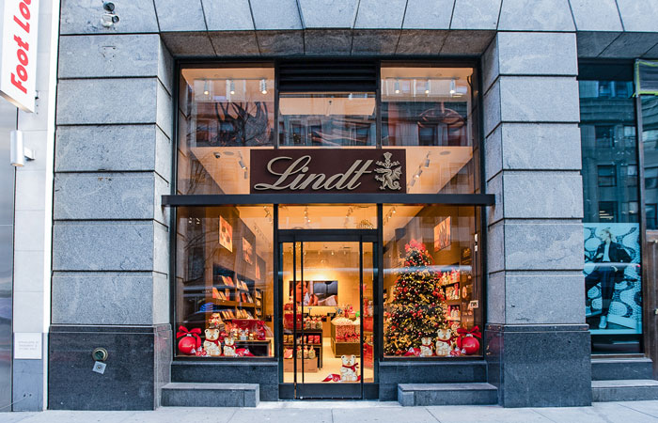
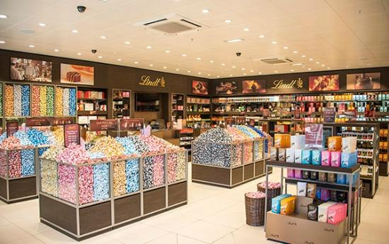
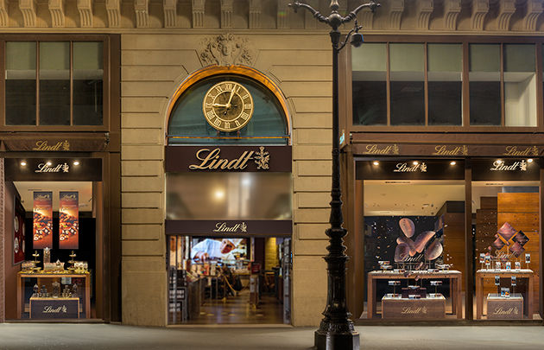
Retail centers
Over 410 chocolate cafés and shops all over the world the world
Paris
New York
London

Slide 7
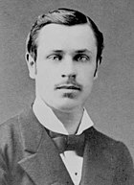
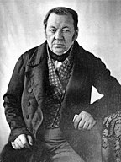
History of the firm
Rodolphe Lindt
David Sprüngli

Slide 8
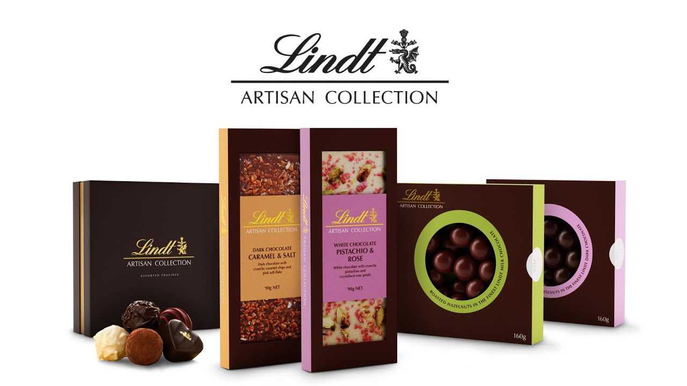
Production methods

Slide 9
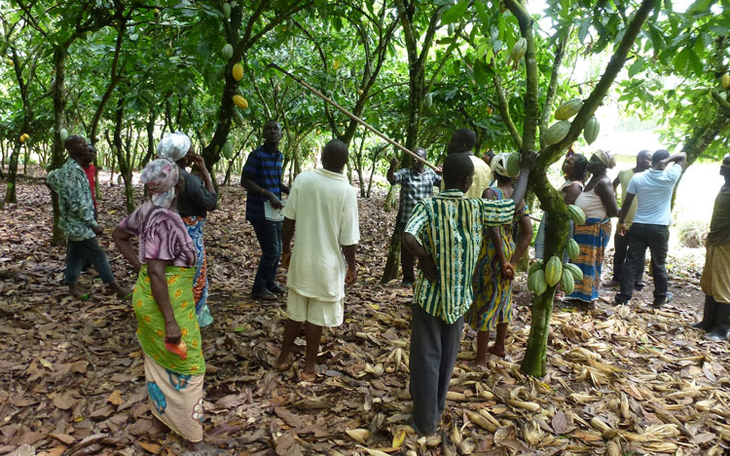
Territorial effect
Lindt farmer training in Ghana

Slide 10
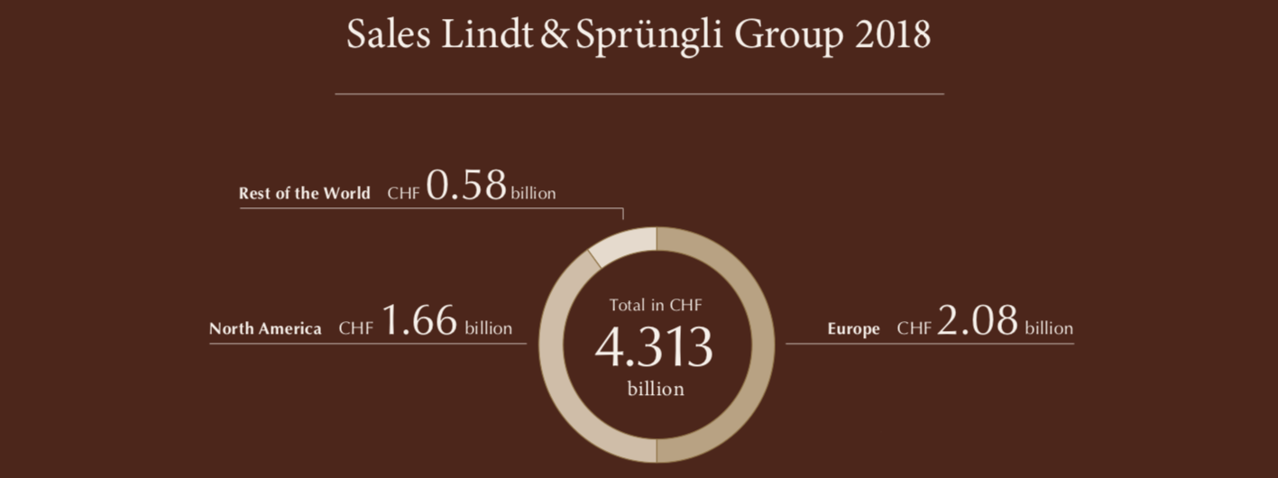
Consumer market

Slide 11
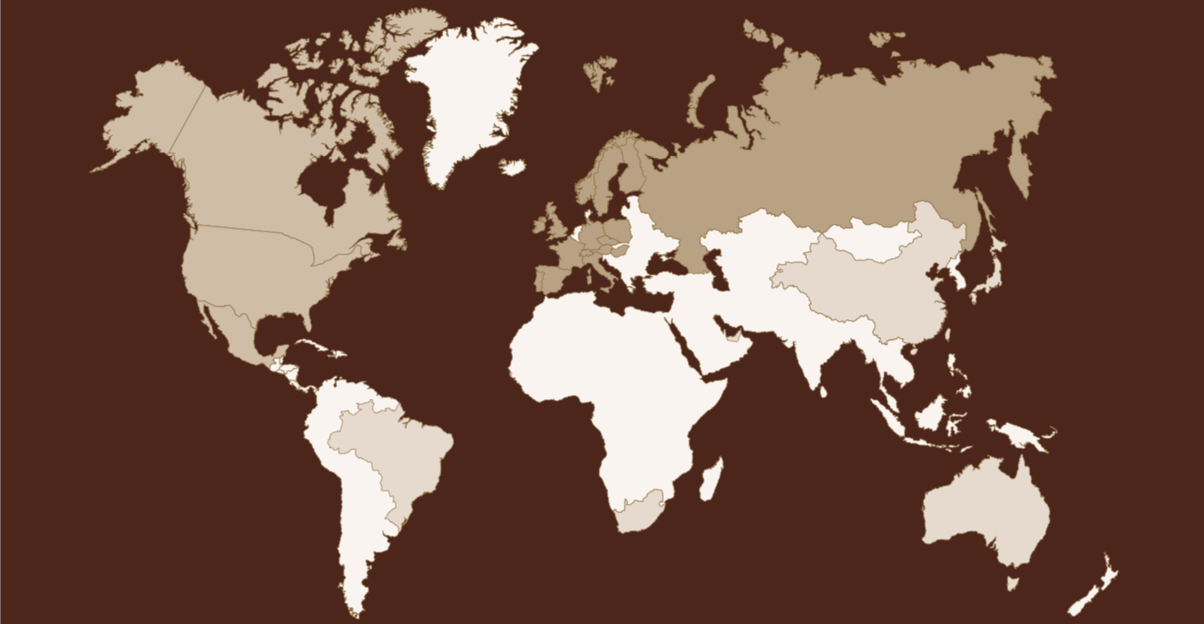
Brand sales:
Global brands owned by Lindt: 76%
Regional brands (Ghirardelli, etc.): 22%
Local brands (Caffarel, etc.): 2%

