Slide 1
MAKE IN INDIA POLICY
DIFFERENT FORMS OF GOVERNMENT -
INDIA :-The Government of India is the democratic form of government, also known as the Central or Union Government or simply the Centre, is the Union government created by the Constitution of India as the legislative, executive and judicial authority to govern the union of twenty eight states and eight union territories. The seat of the government is located in New Delhi.
CHINA :-The Government of the People's Republic of China is collectively the state authority in the People's Republic of China (PRC) under the exclusive political leadership of the Chinese Communist Party (CCP). It consists of legislative, executive, military, supervisory, judicial, and procuratorial branches.The National People's Congress (NPC) is the highest state organ, with control over the constitution and basic laws, as well as over the election and supervision of officials of other government organs. The congress meets annually for about two weeks in March to review and approve major new policy directions, laws, the budget, and major personnel changesmilitary

Slide 2
RUSSIA:-The government of Russia exercises executive power in the Russian Federation. The members of the government are the Prime Minister, the deputy prime ministers, and the federal ministers. It has its legal basis in the Constitution of the Russian Federation and the federal constitutional law "On the Government of the Russian Federation". The Apparatus of the Government of Russia is a governmental body which administrates the activities of the government
U.K :- the government of the united kingdom, domestically referred to as her majesty's government, is the central government of the united kingdom of great britain and northern ireland. the government is led by the prime minister (currently boris johnson, since 24 july 2019) who selects all the other ministers. the country has had a conservative-led government since 2010, with successive prime ministers being the then leader of the conservative party. the prime minister and their most senior ministers belong to the supreme decision-making committee, known as the cabinet.

Slide 3
INDUSTRIALISATION
Industrialisation is the period of social and economic change that transforms a human group from an agrarian society into an industrial society. This involves an extensive re-organisation of an economy for the purpose of manufacturing. Historically industrialization is associated with increase of polluting industries heavily dependent on fossil fuels; however, with the increasing focus on sustainable development and green industrial policy practices, industrialization increasingly includes technological leapfrogging, with direct investment in more advanced, cleaner technologies.

Slide 4
MAKE IN INDIA POLICY
Make in India is a major national programme of the Government of India designed to facilitate investment, foster innovation, enhance skill development, protect intellectual property and build best in class manufacturing infrastructure in the country. The primary objective of this initiative is to attract investments from across the globe and strengthen India’s manufacturing sector. It is being led by the Department for Promotion of Industry and Internal Trade (DPIIT), Ministry of Commerce and Industry, Government of India. The Make in India programme is very important for the economic growth of India as it aims at utilising the existing Indian talent base, creating additional employment opportunities and empowering secondary and tertiary sector. The programme also aims at improving India’s rank on the Ease of Doing Business index by eliminating the unnecessary laws and regulations, making bureaucratic processes easier, making the government more transparent, responsive and accountable

Slide 5
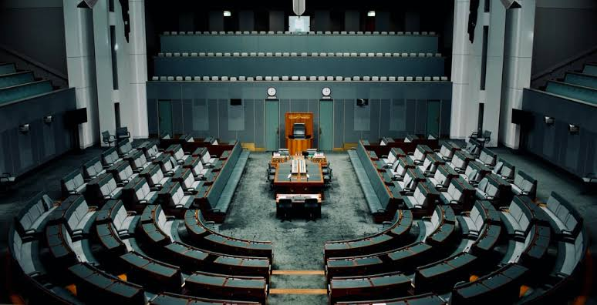
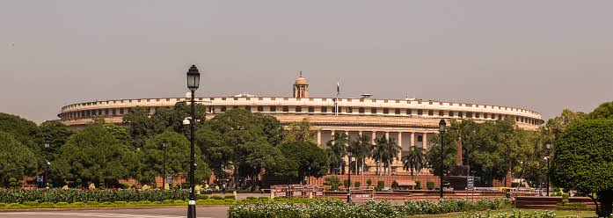
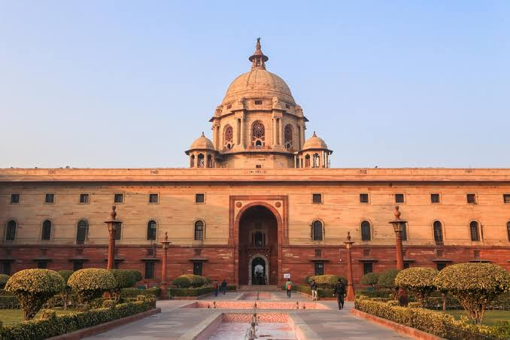
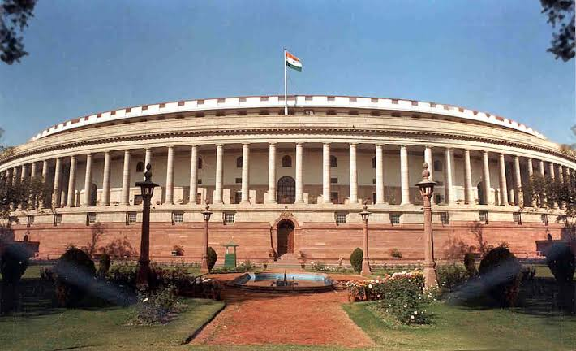
Mock parliament in India

Slide 6
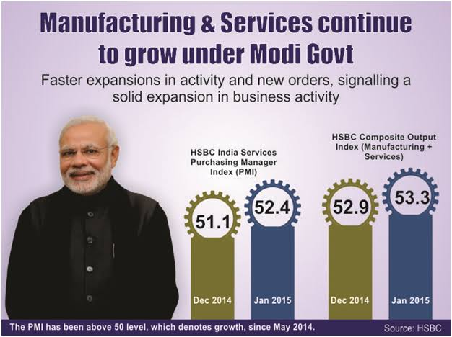
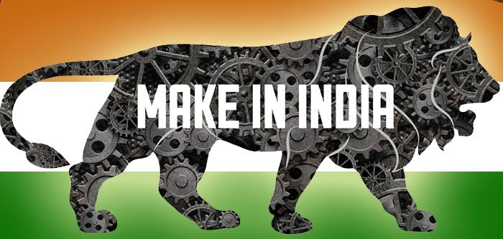
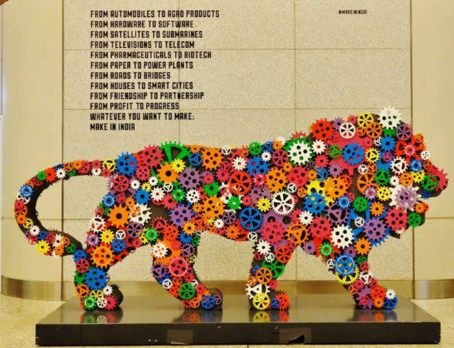
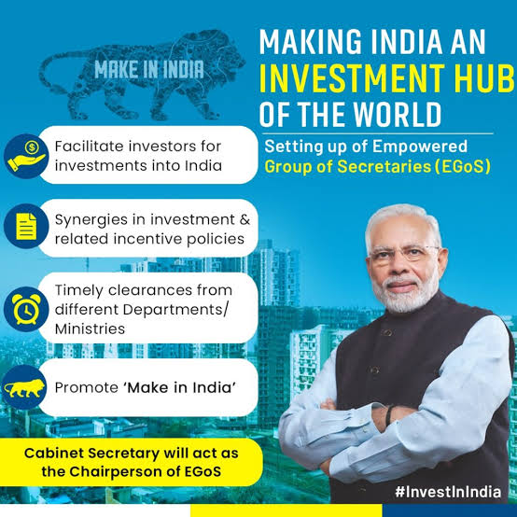
MAKE IN INDIA POLICY

Slide 7
