Slide 1
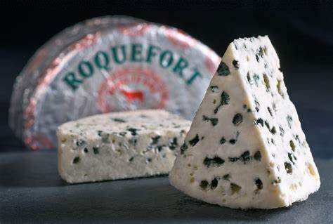
Roquefort cheese

Slide 2
Roquefort cheese
Roquefort cheese is known for its blue spots that vein its white paste. These famous molds make the reputation and the taste of this rich cheese.
This cheese is mentioned for the first time in the 11th century, which makes it a historical symbol of the region of the causses and valleys of the Aveyron. This rural region, established on a soil sometimes very difficult to exploit, has made it its financial and cultural wealth.
It has an international reputation and is associated with the excellence of French agriculture and its gastronomy. It has even become the emblem of the resistance of producers and processors of raw milk cheese against the repeated demands of the generalization of the pasteurization of milk. It exists today in industrial and dairy form, its farm form having totally disappeared at the beginning of the 20th century.

Slide 3
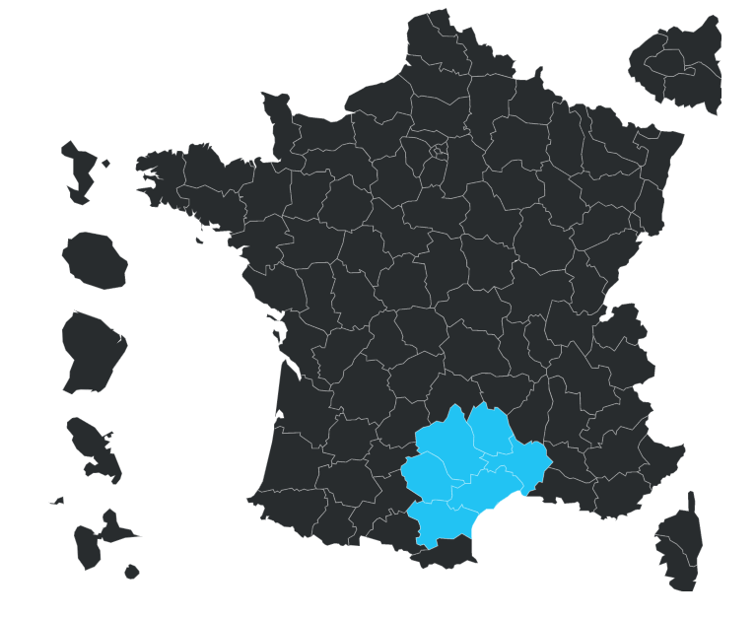
Attention, the production of this cheese is not authorized in all the communes of these departments

Slide 4
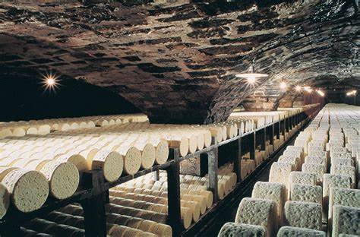
legend
Legend has it that a shepherd forgot a piece of sheep's cheese in a cave and found it some time later covered with mold.Curiosity led him to taste it and the result was so appreciated that it became a local specialty. Each producer has his own specificities.

Slide 5
The identity
The identity of Roquefort tends to become clearer thereafter until the modern era. Indeed, successive kings issued letters patent or decrees that gave privileges to the commune of Roquefort-sur-Soulzon for the production of cheese. The first to grant these privileges was Charles VI in 1407, who gave the commune the right to elect its consuls in the interest of the local cheese trade. We can also count Charles VII, Louis XIV and François I. One of the most important measures was the delimitation, in 1666, of a perimeter defined for the maturing of Roquefort in a cellar: outside of this perimeter, the cheese could not benefit from the appellation "Roquefort". Thus, the production of fake Roquefort was limited. The period thus brings a confirmation of the bases of the identity of the cheese, it guarantees the belonging of the Roquefort to its place of origin, to the soil.

Slide 6
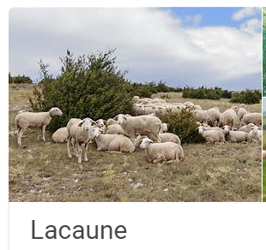
The production of Roquefort cheese follows six distinct steps
1. the milk of the Lacaune breed of sheep must be collected.
2. he renneting and curdling of the milk
3. the cutting and stirring.
4. molded and then sprinkled with Penicillium Roqueforti.
5. creates the well-known greenish spots that make it special.
6. the maturing process, which is fixed at 14 days in the cellar, or more if necessary.

Slide 7
Production
It is a fungus called penicillium roqueforti that is responsible for the mold. It is added to the milk during the manufacturing process. To encourage its development, the cheese is pierced with forty holes all over its height. The humidity and the perfect control of the cellar temperature also play an important role in its appearance. It is this fungus that gives the cheese its taste and smoothness.
For 15 days to 3 weeks, the cheese is exposed in the cellars. When the cellar master considers that the development of Penicillium roqueforti within the cheese is sufficient, the "loaves" are wrapped in tin foil and kept in rooms at low temperature to continue their slow maturation. A minimum of three months is necessary to produce Roquefort cheese.

Slide 8
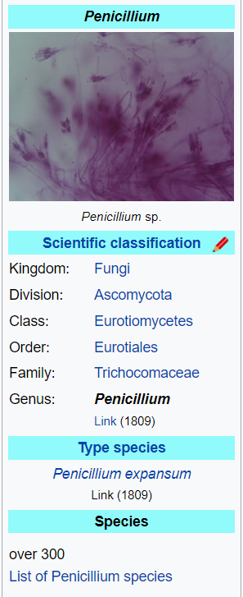
Penicillium is a genus of ascomycetous fungi that is part of the mycobiome of many species and is of major importance in the natural environment, in food spoilage, and in food and drug production.

Slide 9
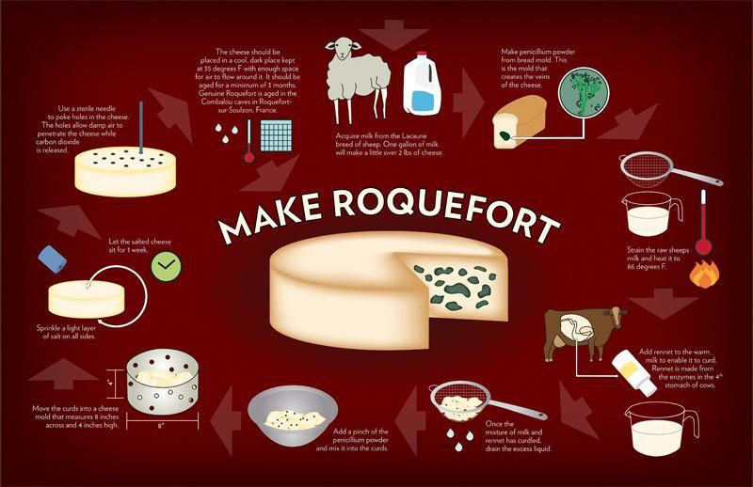

Slide 10
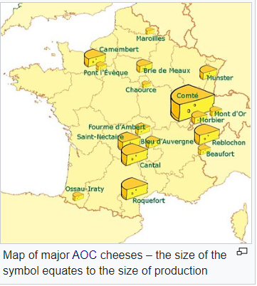

Slide 11
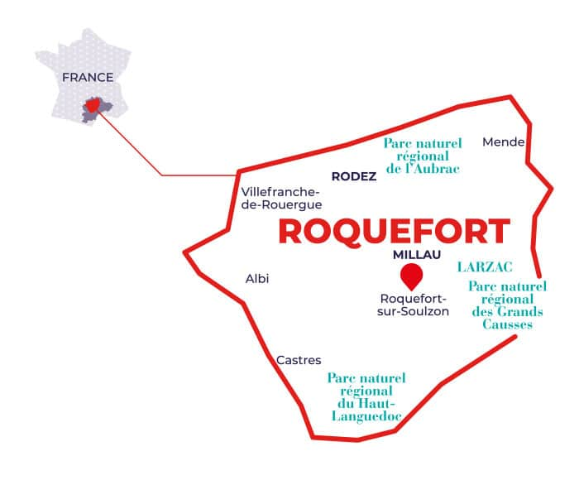

Slide 12
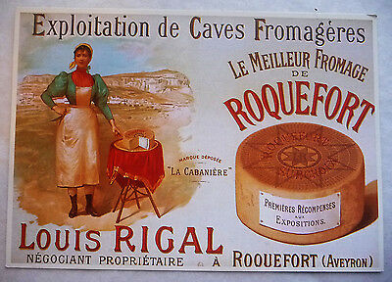
This development led to the creation of many companies. The first one is that of Louis Rigal, "Rigal et compagnie" in 1842. These companies equipped themselves with machines and created jobs for the population of Aveyron. They promoted the cheese through their advertisements.

Slide 13
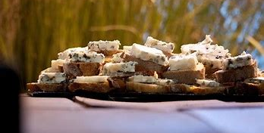
Over the years, this blue cheese has developed. It has become popular thanks to the increase in its production due to the numerous revolutions (demographic, agricultural, transport, industrial). It began to be exported beyond the borders of Aveyron. It is one of the symbols of the South of France. It became famous thanks to its very pronounced taste and its original aspect which seduced many people. This cheese arrives little by little in the more modest houses, it is not reserved any more exclusively to the connoisseurs or to the aveyronnais. This export contributed to its success which continued in the following century.

Slide 14
Progressively, Roquefort has conquered new markets: Europe and America, then Asia, Africa and Oceania. It is now sold on all 5 continents.

Slide 15
wordbox
label :Special mark introduced by a professional organization to identify and guarantee the origin and a level of quality.
AOC : guarantees that the product has been processed and elaborated in a specific geographical area. The AOC label is a European sign. It protects the name of the product throughout the European Union.
AOP : designates a product whose production stages are carried out according to a recognized know-how in the same geographical area, which gives the product its characteristics. It is a European sign that protects the name of the product throughout the European Union.

Slide 16
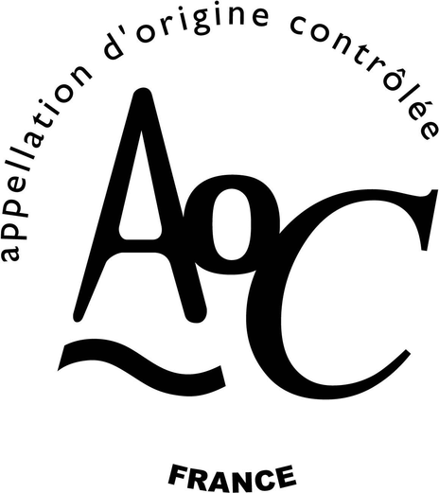
AOC
In France, the appellation d'origine contrôlée (AOC, "Controlled Designation of Origin") is a certification of authenticity granted to certain geographical indications for wines, cheeses, butters, and other agricultural products, under the auspices of the Institut national de l'origine et de la qualité (INAO), based upon the terroir and a form of geographic protectionism.

Slide 17
AOP
The protected designations of origin are born from a European regulation of 1992 which aims to protect all the AOC at the level of the Community by maintaining their specifications which are imposed, from now on, to the other States of the Union, particularly at the geographical level. The AOP allow to keep a close link between the AOP and the land where they are produced.
Of course, all French cheese AOC are also AOP.
The law governing the principle of the AOC was passed in France in 1919.
The first French cheese AOC was created by a law in July 1925: Roquefort
Law of 26 07 1925
Decree AOC ROQUEFORT 22 01 2001
INAO's sheet on Roquefort cheese
Site of the National Institute of Origin and Quality

Slide 18
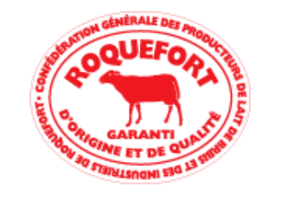
LABEL BREBIS ROUGE
Since 1930, Roquefort has been awarded the "red ewe label" which regulates the feeding of the ewes: fodder and cereals in winter, pasture the rest of the time. It should also be noted that the milk comes only from Lacaune breed ewes.
This label is a collective mark created in 1930 by the Confédération des Producteurs de Lait de Brebis et des Industriels de Roquefort. It certifies the origin and the quality of Roquefort cheese all over the world.

Slide 19
It is the notion of terroir that is the basis of the concept of Appellations of Origin.
A terroir is a particular geographical area where a product draws its originality directly from the specificities of its production area. A terroir is a delimited area in which a human community has built up a collective production know-how over the course of its history. It is based on a system of interactions between a physical and biological environment and a set of human factors. This is where the originality and typicality of the product are found.

Slide 20
Conclusion
We can say that Roquefort is a cheese that is very attached to its place of origin and production. Its identity as a cheese of the land was built up as early as the medieval period and has continued to be strengthened over the centuries, particularly since the 19th century. Indeed, even with the rapid industrialization and machinization, and the marketing that opened up to globalization, Roquefort was able to preserve its local and traditional image. This image has been officially recognized by the kings of the modern era and then labeled through the AOP certification for example. Moreover, the production of Roquefort has allowed the development of a perennial economy at the local level since the cheese has to pass through the cellars of Roquefort-sur-Soulzon in Aveyron. Roquefort is a cheese with an identity that has remained attached to the land through the ages and their evolution.

Slide 21
Sources
https://agriculture.gouv.fr/tropfortleroquefortaop#:~:text=Chaque%20année%2C%20près%20de%2018%20830%20tonnes%20de,exclusivement%20élaboré%20avec%20des%20brebis%20de%20race%20Lacaune.
https://www.quiveutdufromage.com/ac-comment-est-fabrique-le-roquefort
https://agriculture.gouv.fr/trop-fort-le-roquefort-aop
https://www.leguidedufromage.com/roquefort-io319.html
https://fr.wikipedia.org/wiki/Roquefort_(fromage)
https://blogs.univ-jfc.fr/vphn/patrimoine-immateriel/le-roquefort-2020/
https://www.roquefort.fr/wp-content/uploads/2021/06/rayon-roquefort.jpg

