Slide 1
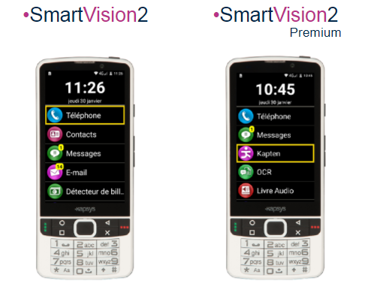
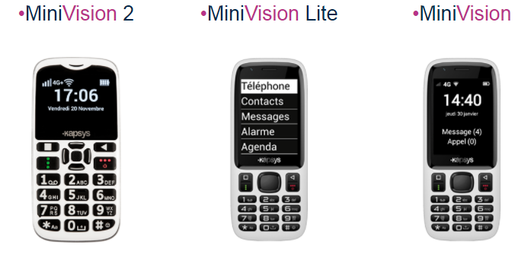
Kapsys
Products made in France

Slide 2
Summary :
1. What does "Made in France" mean ?
2. Kapsys on a Map
3. History of Kapsys
4. Kapsys on a multiscale approach

Slide 3
1. What does "Made in France" mean ?
Article 39 : foreign products marked as "Made in France" are forbidden
Article L121-1 : indications on products must be true (composition or origin)
Article L213-1 : set a sentence on false claims concerning products
Article L217-6 :set a sentence on false claims concerning the products' origins

Slide 4
2. Kapsys on a Map.
20 countries accross the world

Slide 5
Partnerships concerning the technologies used in phones

Slide 6
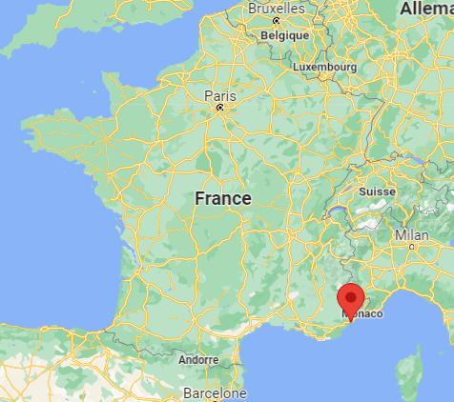
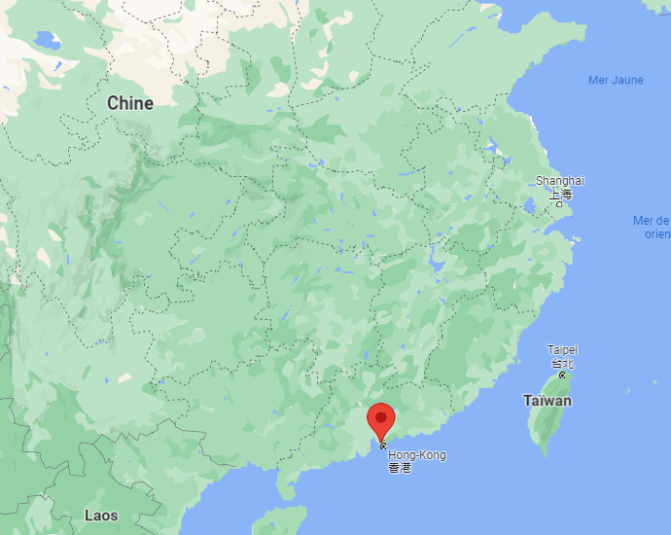
The Headquarters are located in Mougins
The production sites were located in Shenzhen before being relocated in Bayonne

Slide 7
3. History of Kapsys
2007
Foundation
2013
Production of phones instead of GPS
2016 - 2017
Kapsys went from Shenzhen to Bayonne

Slide 8
4. Kapsys on a multiscale approach

Slide 10
Thank you for listenning !
KAPSYS - Spécialiste des solutions de mobilité et de communication
Où se cachent les objets électroniques “Made in France” ? (linfodurable.fr)
Société KAPSYS à Mougins (Chiffre d'affaires, bilans, résultat) avec Verif.com - Siren 494215783
KAPSYS (MOUGINS) Chiffre d'affaires, résultat, bilans sur SOCIETE.COM - 494215783
Aram Hekimian, l’Arménien le plus riche de l’Hexagone (sudouest.fr)
Kapsys relocalise à Bayonne - Actualité Societe.com

