Slide 1
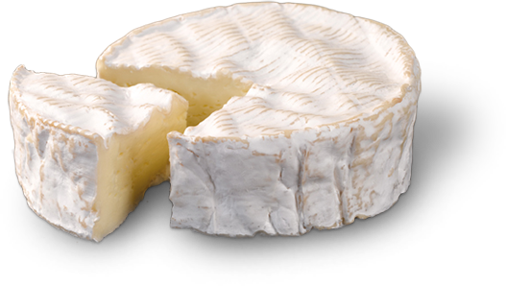
The Camembert
Of Normandy

Slide 2
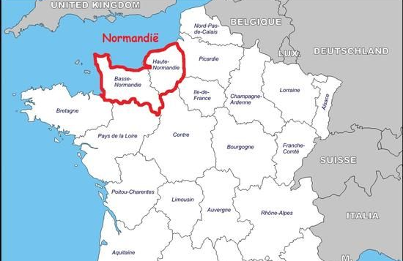
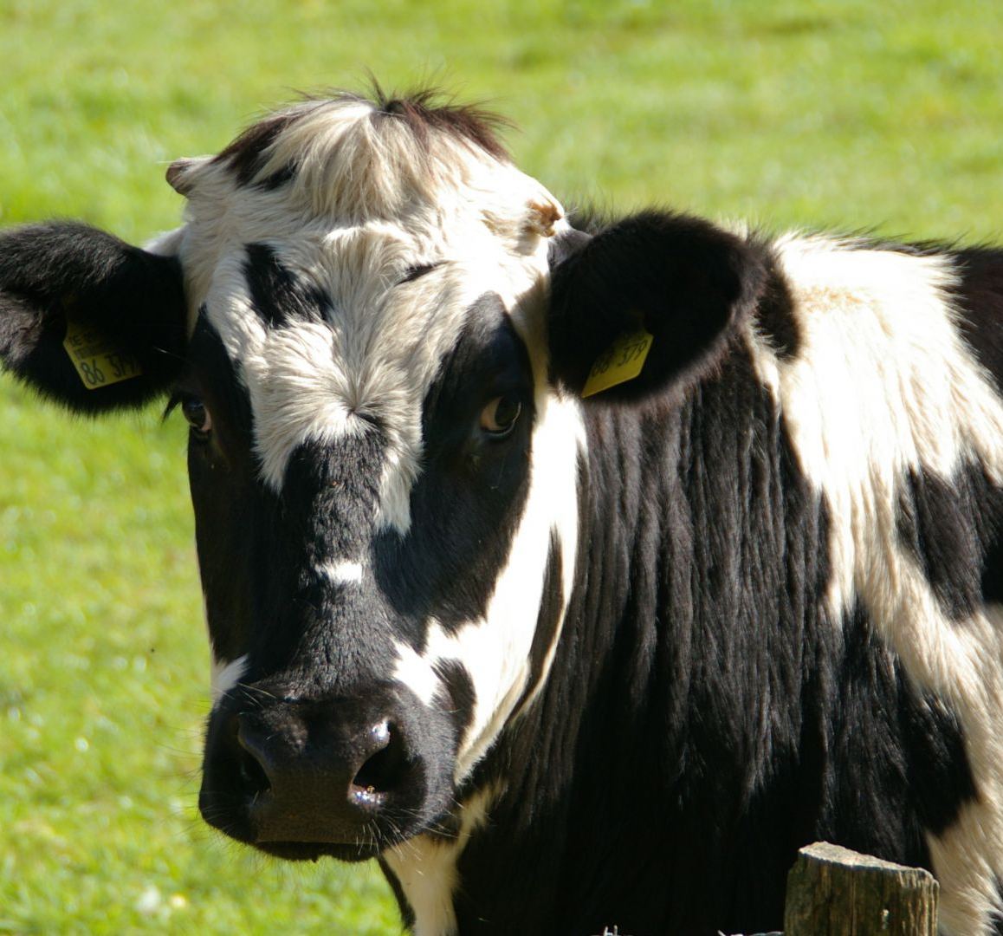
One of the best french cheese
Made from raw cow's milk
AOC in 1983
PDO in June 1996
Others names: claquos, calendros, camembos, compté coulant

Slide 3
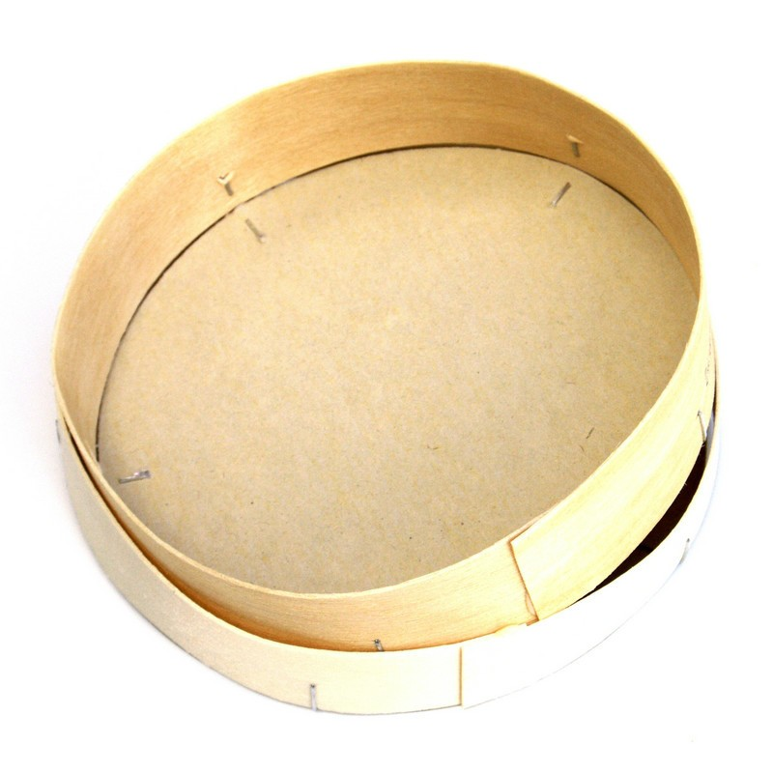
Thanks Marie Harel
Developped in 1791 on her farm in Beaumoncel.
How to travel easy ? Wooden box ! -->
Idea by Charles Jean Bonvoust
Thanks to the arrival of railway in Normandy, the camembert can be spread widely
"Camembert" has been qualified as a generic term
In 1983 the camembert of Normandy obtained an AOC

Slide 4
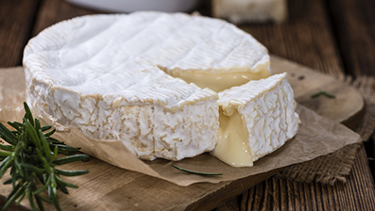
How is it ?
Weight: 250g
Cylindrical shape, diameter: 10.5 from 11cm
Crust white and flowery
Can reveal spots of red or orange
Paste: both smooth and supple
Typical slightly salty flavour

Slide 5
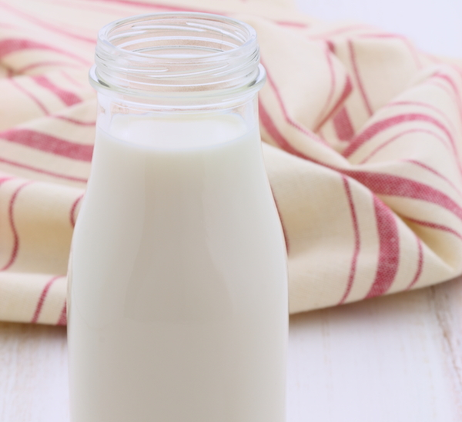
Requires 2.2 liters of raw cow's milk
Involves severals important steps:
Heating, trapping and maturing of milk
Curd molding
Demouling
Salting, canning and refining

Slide 6
Statistics
Society games
Famous brands:
Président
Pâturages
Cœur de lion

Slide 7
To conclude

