Slide 1
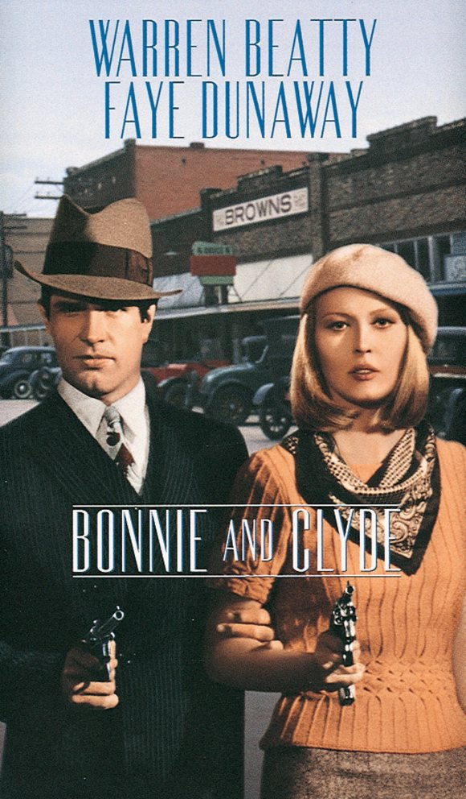
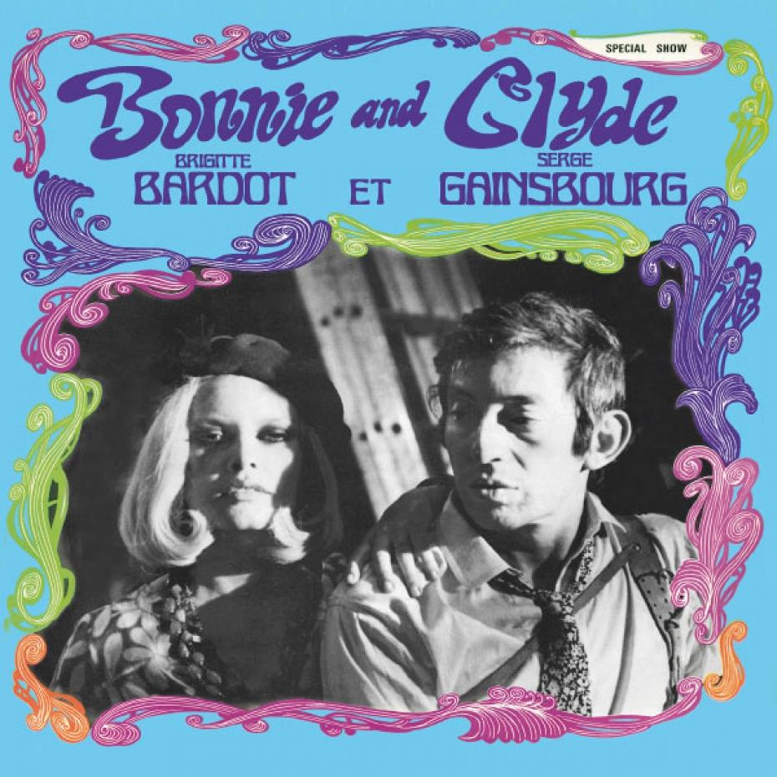
The trail’s end, Bonnie Parker (1934) // Bonnie and Clyde, Serge Gainsbourg (1968)

