Slide 1
Pistes de travail possibles
The Importance of Being Earnest
by Oscar Wilde

Slide 2
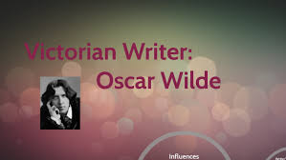
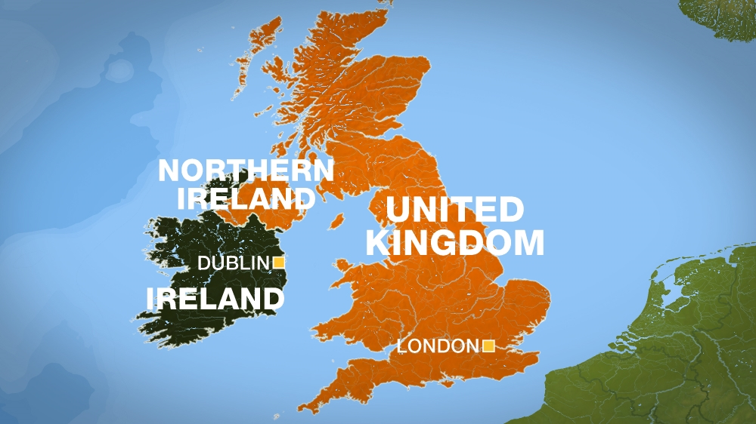
1854-1900

Slide 3
Victorian Society
Issues:
The moralism of Victorian society
The constraints of morality
Earnestness: the Importance of Not Being Earnest
The nature of marriage
Double life: (Earnest / Jack – Algernon/ Bunburying)
Literary devices like:
Puns: Earnest / Ernest/ Miss Prim / misprision…

Slide 5
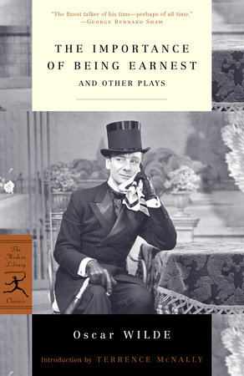
-Type of work: a play - Genre: social comedy / comedy of manners / satire
s
1895

Slide 6
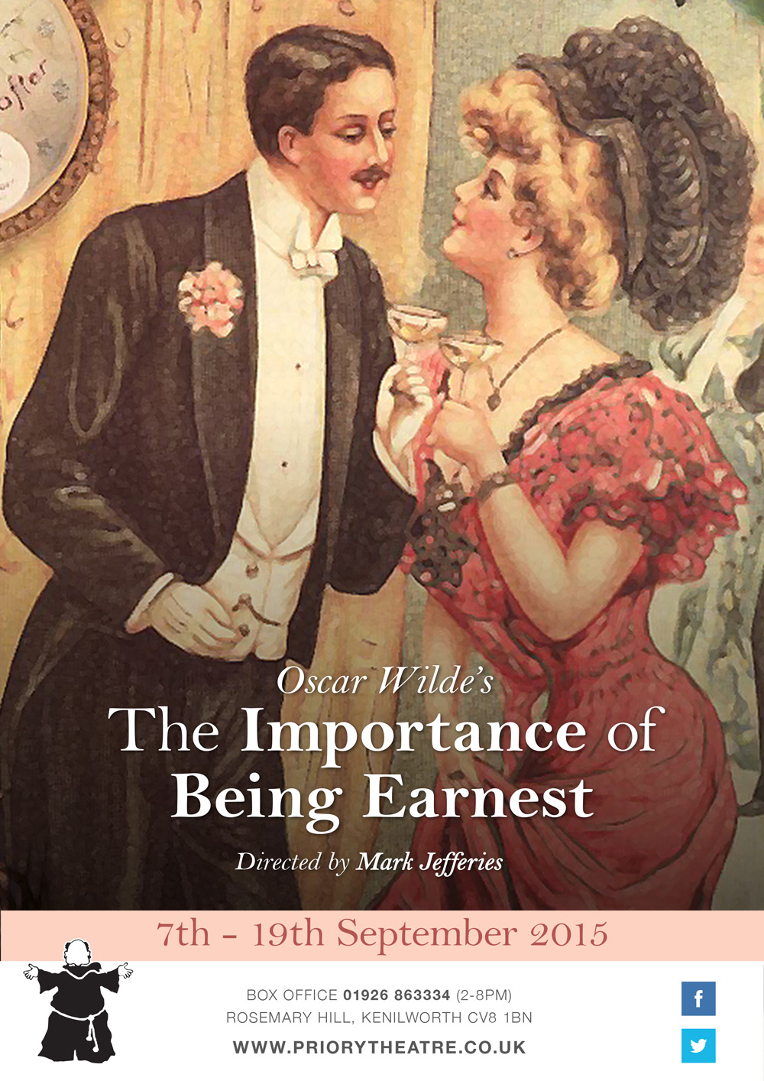

Slide 7
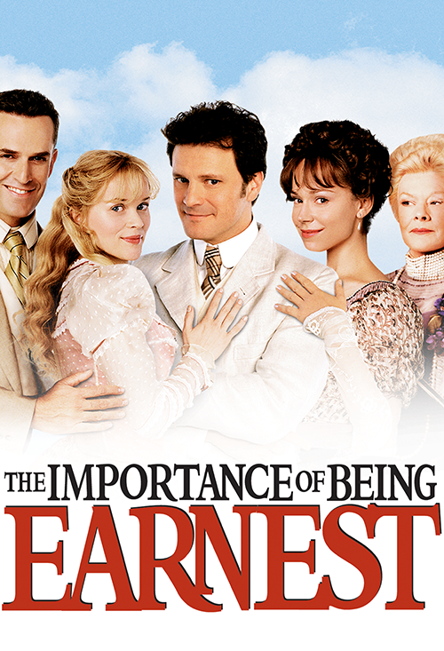
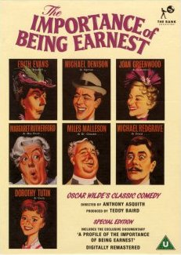
Film directed by Anthony Asquith and released in 1952
Film released in 2002 and directed by Alan Parker

Slide 8
Thesis statement: key-question:
To what extent can we be earnest in a society full of pretence ?

Slide 9
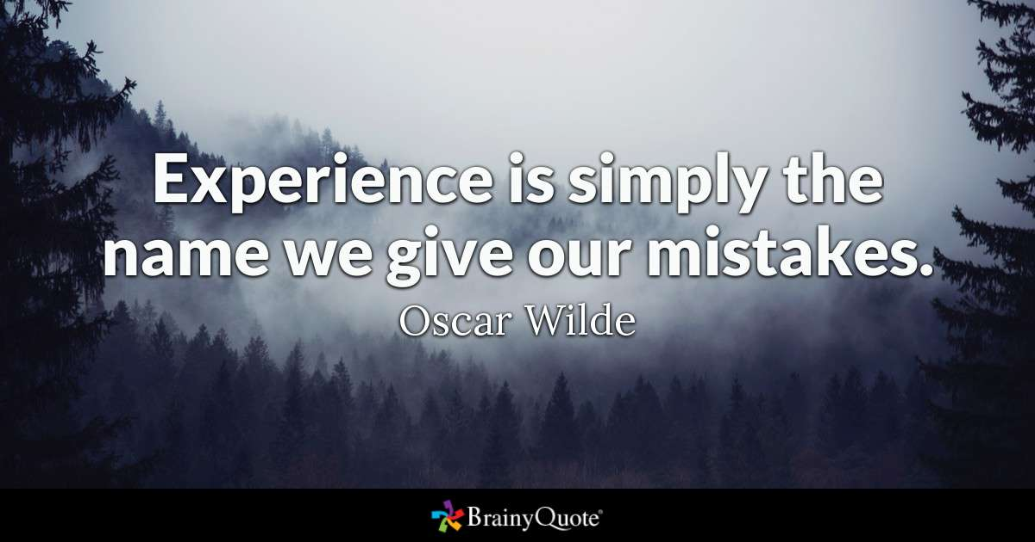
- Working on quotations from the play: - Learning them by heart and being able to recite them as well as possible!
Working on the quotations from the play and learning them by heart!
« The truth is rarely pure and never simple »
« In matters of grave importance, style,
not sincerity, is the vital thing »
« To be natural is such a very difficult pose
to keep up »
« Never speak disrespectfully of society –
only people who can’t get into it do that »

Slide 11
Other Victorian authors
Discovering and presenting other Victorian authors like the novelists, Charles Dickens, Lewis Caroll,
George Eliot and Thomas Hardy,
or poets like Robert Browning, Alfred Tennyson,
Talking about other plays, George Bernard Shaw’s plays, for example!
Let us not forget The Happy Prince
and The Picture of Dorian Gray by Oscar Wilde.

Slide 12
Extract from the play

Slide 13
Working on a scene
Les spécificités du genre: le théâtre
Asking the students how they could perform it and then watching the same extract from the play directed by Stephen Wrentmore (2013)
OR / AND
Discovering a new staging with new theatrical scenery. (another stage adaptation by Adrew London and Emma Reeves
Discovering the play directed by the French director
Gilbert Désveaux
OR / AND
Working and comparing the costumes chosen from two different performances / WORKING ON THE MUSIC CHOSEN.
Idées de réécriture: version moderne
Les spécificités du genre : le théâtre

Slide 14
Watching the trailer and comparing a scene from the film adaptation to the corresponding scene from the book

Slide 15
Final task
WRITING AND ACTING OUT AN EARNEST AND HYPOCRITICAL PROPOSAL ( PAIR WORK)
« il serait intéressant de jouer la même scène et de montrer que la manière de jouer peut modifier le sens ( la voix, l’intonation, gestes, ton, timing, expression , déplacements. »

Slide 16
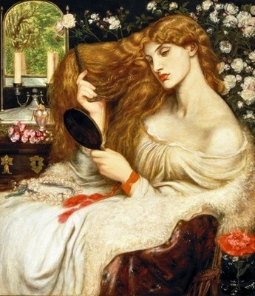
BRANCHING OUT:
Paintings ( pre-raphaelite works of art)
Discoveries
( The Oxford English Dictionary…)
Women in Victorian society…
Lady Lilith by Dante Gabriel Rossetti – 1866-1868

