Slide 1
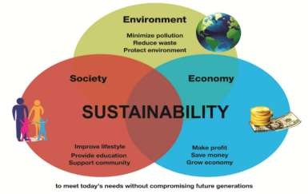
How to make this village more sustainable ?
What for ?
To be autonomous
To preserve the coastal environment To reduce waste and Carbon emissions
How ?
Fresh water
Hot water
Marine electrical energy
Local food
Biodiversity
Waste management
Green transportation

Slide 2
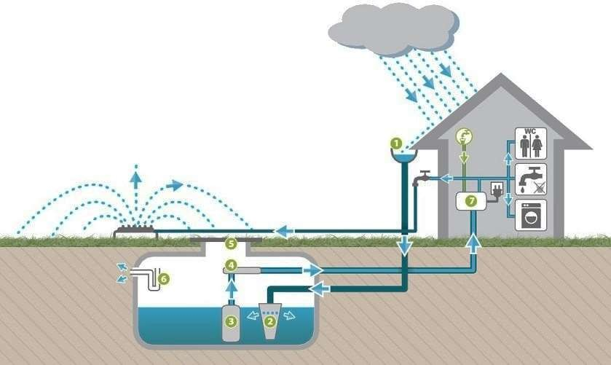
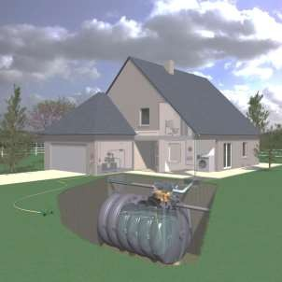
Fresh water supply
Rainwater harvesting

Slide 3
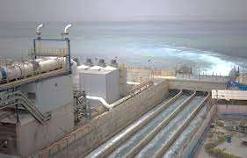
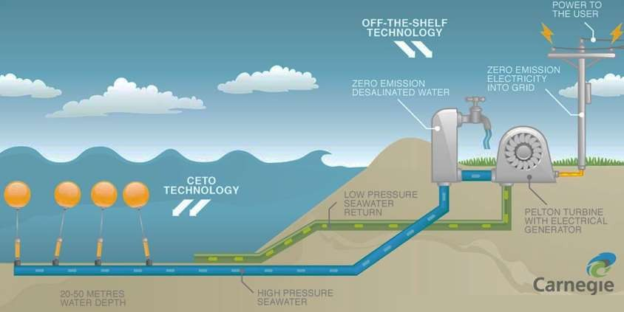
Fresh water supply
Desalination of sea water
Desalination plant

Slide 4
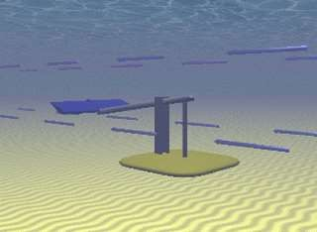
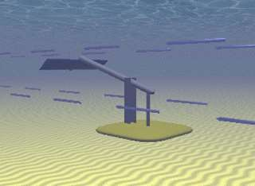
Green electricity supply
Oscillant hydrofoils
Electric cables
Dispatching
substation

Slide 5
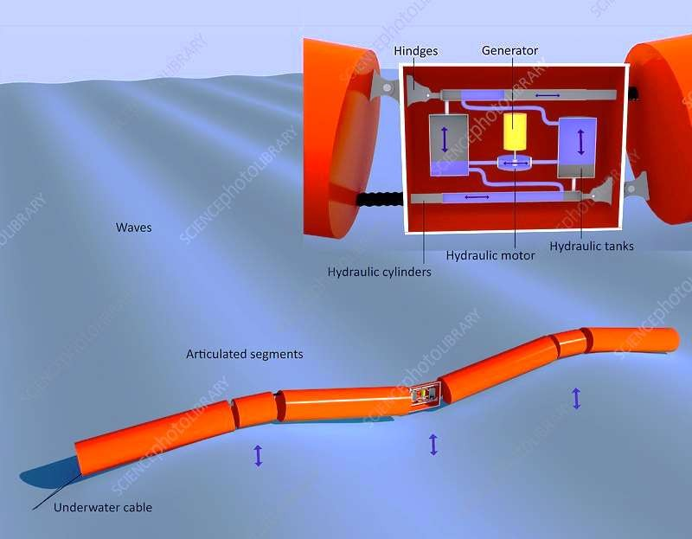
Green electricity supply
Pelamis
Electric cables
Dispatching
substation

Slide 6
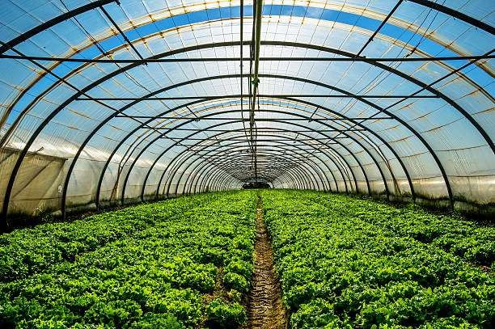
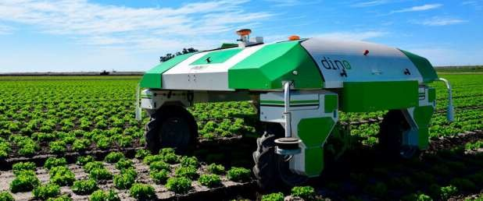
Vegetable gardening
Green houses
Vegetable farming

Slide 7
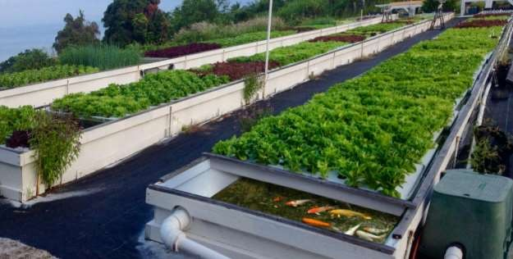
Vegetable gardening
Aquaponics
(water farming technique using
both fishes and vegetables)

Slide 8
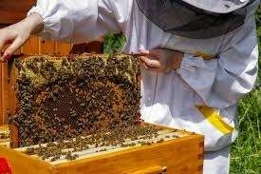
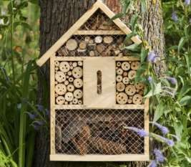
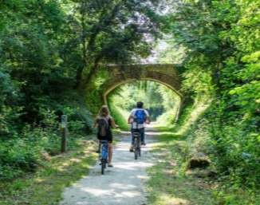
Biodiversity protection
Insect hotels
Bee hives
Bike lanes

Slide 9
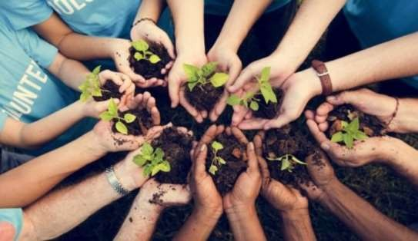
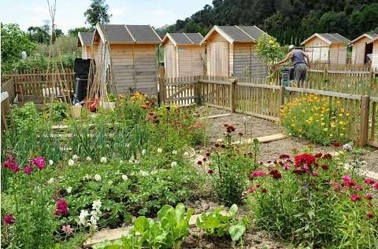
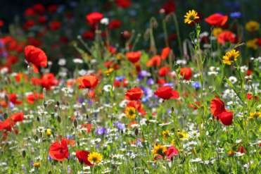
Biodiversity protection
Tree planting events
Shared gardens

Slide 10
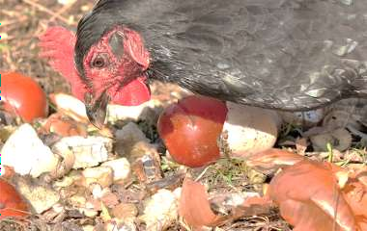
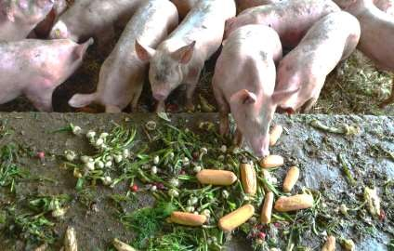
Waste management
Animal breeding
Food waste

Slide 11
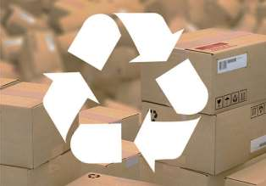
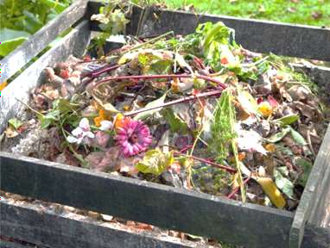
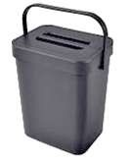
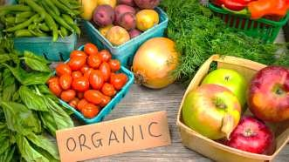
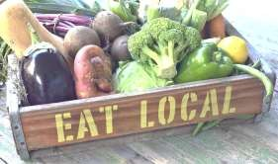
Waste management
Food waste
Recyclable packaging
Collective compost
Buy local and in bulk

Slide 12
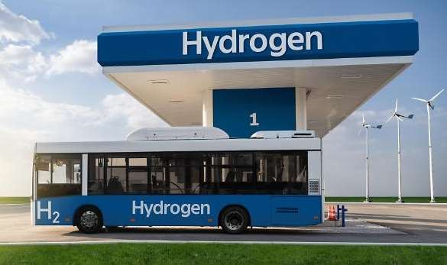
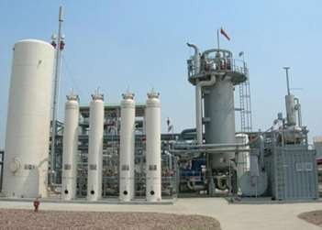
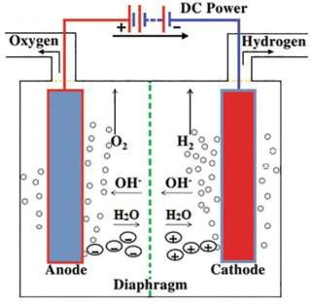
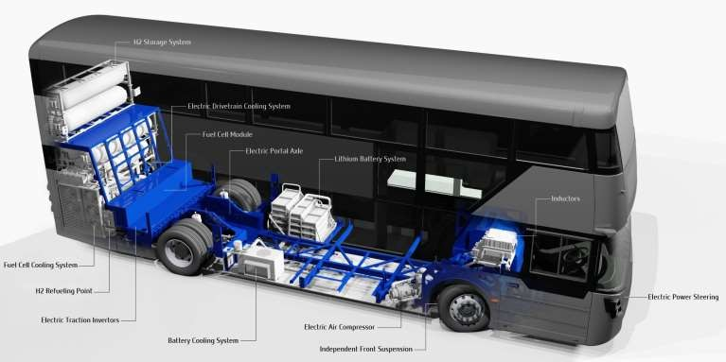
Green transportation
Hydrogen factory
Hydrogen bus
Water electrolysis

Slide 13
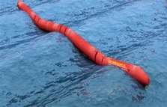
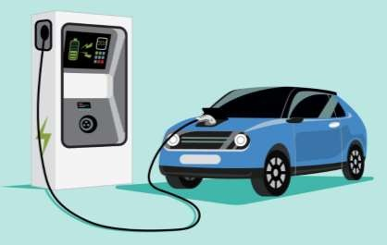
Green transportation
Electric car sharing
Electricity produced by local sustainable
sources

Slide 14
How to make this village more sustainable ?
Many thanks to
Nina Esteban Evan
Sasha Noé Ethan
Sacha Maïa Ethan
Emma Salomé Hugo
Romane
Louis
Antonin
Alban
Tess Enzo
2021 - 2022

