Slide 1
Welcome to the city that never sleeps
Scénario n°1 - TSEN

Slide 2
Séance 1 - Speaking

Slide 3
Speaking

Slide 4
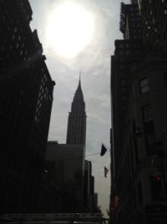
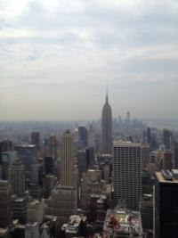
Speaking

Slide 5
Speaking

Slide 6
Speaking

Slide 7
Speaking

Slide 8
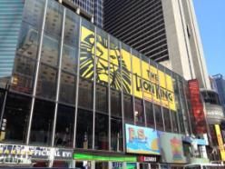
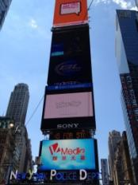
Speaking

Slide 9
Speaking

Slide 10
Speaking

Slide 11
Speaking

Slide 12
Speaking

Slide 13
Speaking

Slide 14
Speaking

Slide 15
Speaking

Slide 16
Speaking

Slide 17
Speaking

Slide 18
Speaking

Slide 19
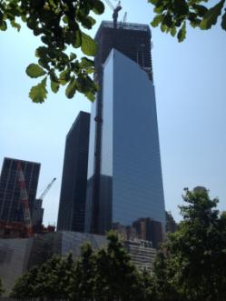
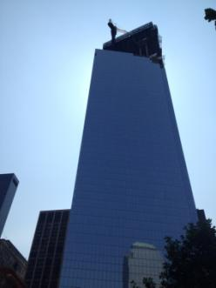
Speaking

